Slide 1
SMuRP
Brendan Armstrong, Brooke Brown, Alyssa Kutney, Caitlin McElwee, Caroline Grala, Kristelle Lucero

Slide 2
What is SMuRP?
SMuRP = Social Music Recommendation Platform
Mobile application that:
Recommends new music based on songs you have liked
Recommends users to follow based on similar listening history

Slide 3
What is SMuRP?
Connects to user’s last_fm account and updates songs they listened to
Allows user to rate songs
Follow and unfollow other users
View what users you follow listen to and what songs they rate
*disclaimer, users don’t us the app to make posts or leave comments

Slide 4


Frontend

Slide 5



Backend
Notes:
Scipy we used for the machine learning aspect of this project
SVD stands for Singular Value Decomposition
We user SVD as a collabaritive filtering algorithm (method to predict a rating for a user item pair based on history of ratings the user gives to the item)

Slide 6
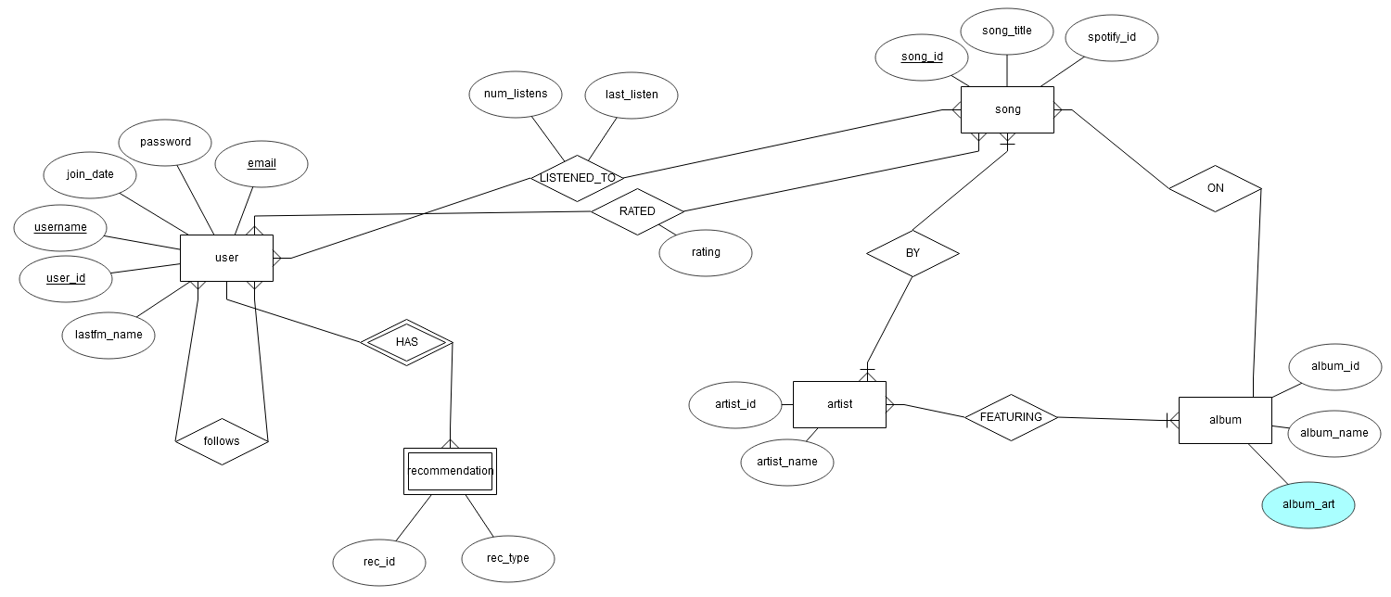
The Database

Slide 7
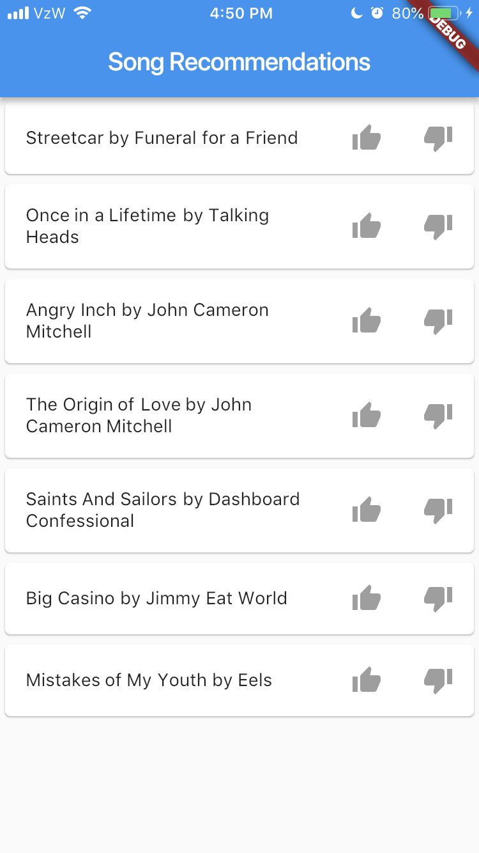
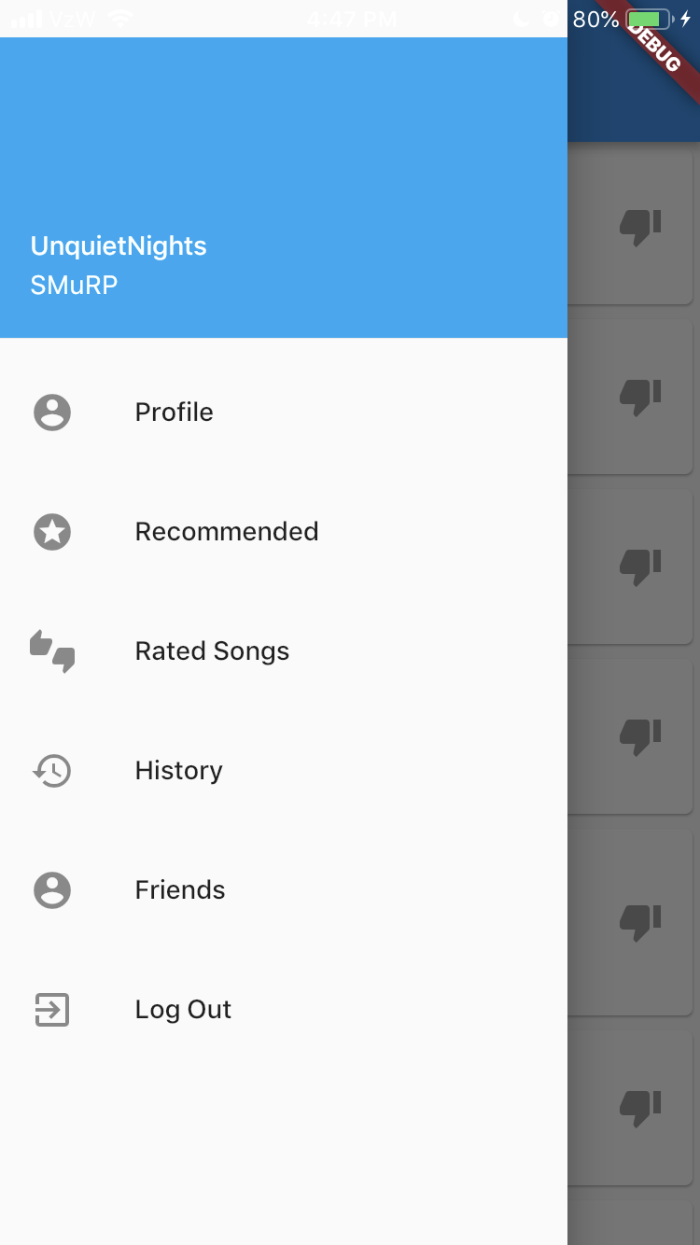
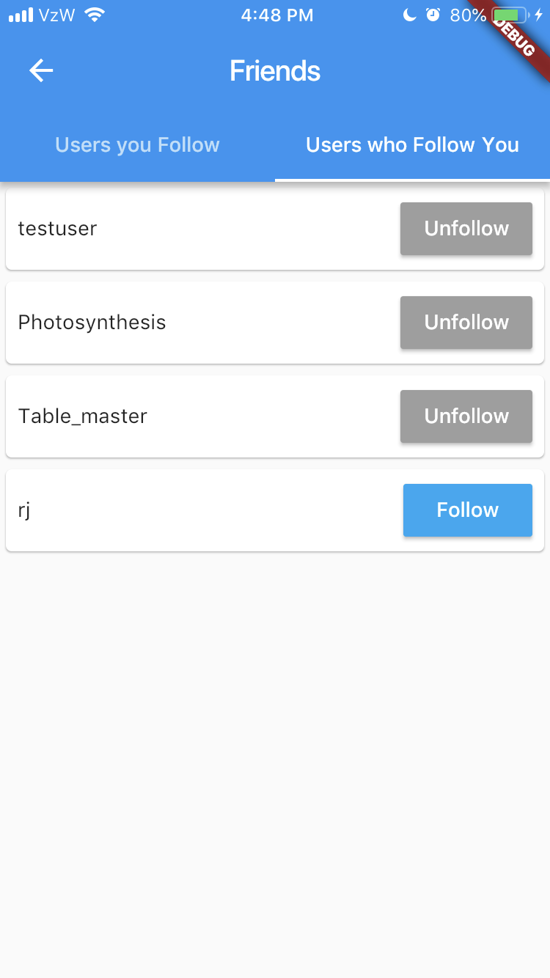
Demo

Slide 8
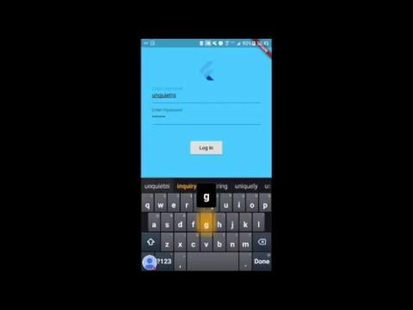
Login

Slide 9
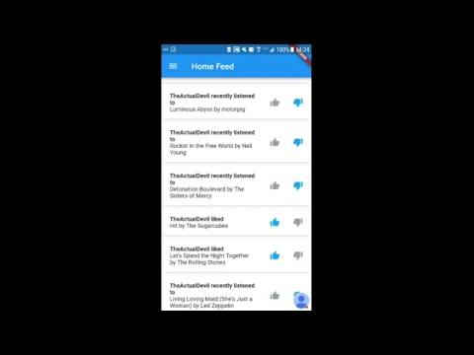
Home Feed

Slide 10
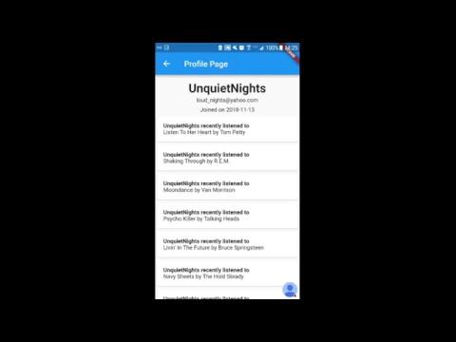
Profile

Slide 11
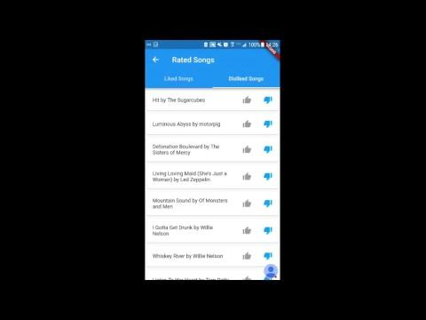
Rated

Slide 12
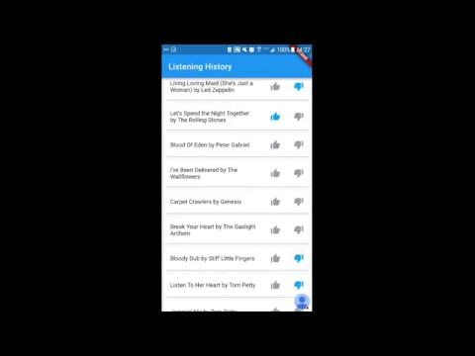
History

Slide 13
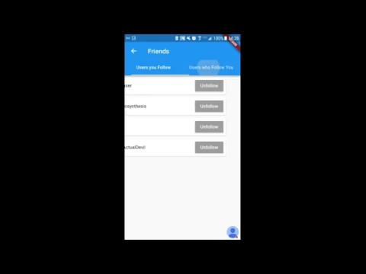
Friends

Slide 14
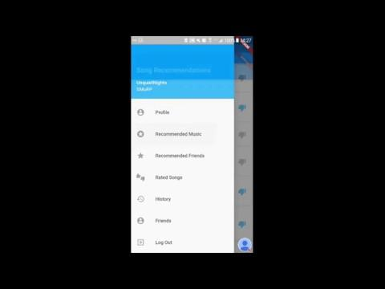
Song Recommendations

Slide 15
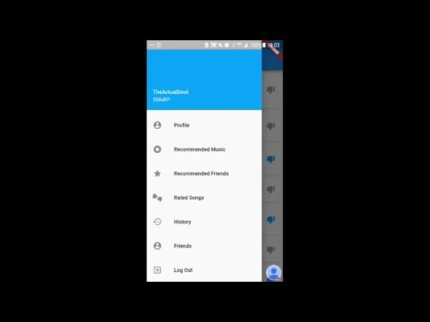
User Recommendations

